Slide 1

CSE - 216
Database Project

Slide 2
Prepared By
Nafiz Imtiaz Chowdhury
ID : 1605074
Samin Sharaf Somik
ID : 1605076

Slide 3
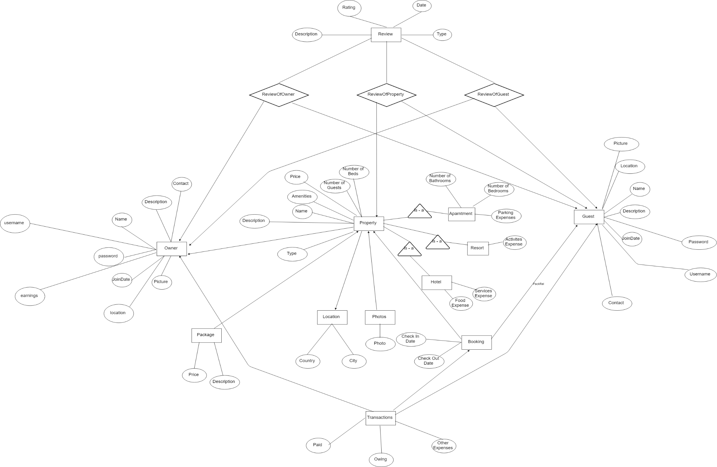
ER Diagram

Slide 4
Schema
Property ( id (PK) , location_id (FK) , owner_id (FK) , name , description, amenities, price, no_of_guests, no_of_beds, type )
Apartment ( ISA Property ) ( no_of_bath, no_of_bedrooms, parking_expenses)
Hotel (ISA Property) ( services_expenses, food_expenses)
Resort (ISA Property) ( activities_expenses)
Booking ( id(PK) , booked_by(FK) , property_id (FK) , check_in_date, check_out_date)
Guests ( id(PK) , name, description, location, join_date, password, username, contact , picture)
Location ( id(PK) , country , city)
Package ( id(PK) , price , description)

Slide 5
Schema
9. Owner ( id(PK) , name , description, contact, join_date, picture,
username, password, location )
10. Photos ( id(PK) , property_id (FK) , photo )
11. Review ( id(PK) , rating , description , rDate )
12. Transaction( id(PK), owner_id (FK) , guest_id(FK) , booking_id (FK) ,
owing, other_expenses, paid )

Slide 6
Query
Search By Availability, No of Guests and location
Search By Location
Get List of Property booked by guest but not reviewed
Get list of bookings on properties owned by owner
Get Property Review
Sign Up Owner
Sign Up Guest
Login Guest
Login Owner

Slide 7
Query
10. Get Property Details
11. Get List of Bookings made by guest
12. Get list of all properties owned by owner
13. Guest Payment
14. Get Reviews of Property
15. Get Package Details of Property
16. Get Photos of Property

Slide 8
Functions
Book Guests
Check Availability
Place Review

Slide 9
Triggers
New Transaction Trigger
Owner Earnings Update Trigger

Slide 10
Project Codes
Queries:
Search By Availability, No. of Guests and location
SELECT P.id AS prop_id, P.name as prop_name , P.no_of_beds, P.type,P.price, O.id AS owner_id, O.name as owner_name FROM public."Property" AS P INNER JOIN public."Owner" as O ON P.owner_id = O.id WHERE checkAvailibility($2, $3, P.id)
AND P.location_id in (SELECT id FROM public."Location" WHERE country=$1 OR city=$1) AND P.no_of_guests>=$4

Slide 11
Project Codes
Queries:
2. Search By Location
SELECT P.id AS prop_id, P.name as prop_name , P.no_of_beds, P.type,P.price, O.id AS owner_id, O.name as owner_name
FROM public."Property" AS P
INNER JOIN
public."Owner" as O
ON P.owner_id = O.id
WHERE P.location_id in
(SELECT id FROM public."Location" WHERE country=$1 OR city=$1

Slide 12
Project Codes
Queries:
3. Get List of Property booked by guest but not reviewed
SELECT P.id AS prop_id, P.name as prop_name
FROM public."Property" AS P
WHERE P.id NOT IN (SELECT R.prop_id
FROM public."ReviewOfProperty" AS R
WHERE guest_id=$1) AND
P.id IN (SELECT B.property_id
FROM public."Booking" AS B
WHERE B.booked_by=$1)

Slide 13
Project Codes
Queries:
4. Get list of bookings on properties owned by owner
SELECT B.id AS booking_id, to_char(B.check_in_date, \'DD-Mon-YYYY\') as check_in_date, to_char(B.check_out_date, \'DD-Mon-YYYY\') as check_out_date, P.name AS prop_name, G.name as booked_by,
T.owing, T.paid
FROM public."Booking" AS B
INNER JOIN
public."Property" AS P
ON P.id = B.property_id
LEFT OUTER JOIN
public."Transaction" AS T
ON (T.booking_id = B.id)
INNER JOIN
public."Guests" AS G ON G.id = B.booked_by
WHERE P.owner_id = $1

Slide 14
Project Codes
Queries:
5. Get Property Review
SELECT R.rating, R.description, to_char(R.date, \'DD-Mon-YYYY\') as date, G.name
FROM public."Review" AS R, public."Guests" AS G
WHERE R.id in (SELECT ROP.rev_id
FROM public."ReviewOfProperty" AS ROP
WHERE ROP.prop_id = $1 AND G.id=ROP.guest_id)

Slide 15
Project Codes
Queries:
6. Sign Up Owner
INSERT INTO public.“Guests"
(name, description, contact,location, username, password)
VALUES ($1, $2, $3, $4, $5, $6)

Slide 16
Project Codes
Queries:
7. Sign Up Owner
INSERT INTO public.“Owner"
(name, description, contact,location, username, password)
VALUES ($1, $2, $3, $4, $5, $6)

Slide 17
Project Codes
Queries:
8. Login Guest
SELECT id
FROM public."Guests" W
HERE (username=$1 AND password = $2)

Slide 18
Project Codes
Queries:
9. Login Guest
SELECT id
FROM public.“Owner"
WHERE (username=$1 AND password = $2)

Slide 19
Project Codes
Queries:
10. Get Property Details
SELECT P.name as propName, L.country, L.city, P.description AS prop_desc, P.amenities, P.package_id as packid, P.price, P.no_of_guests, P.no_of_beds, O.name as owner_name,
O.id as owner_id, O.description AS owner_desc
FROM public."Property" AS P
LEFT OUTER JOIN public."Owner" AS O
ON P.owner_id = O.id
LEFT OUTER JOIN public."Location" AS L
ON P.location_id = L.id
WHERE P.id = $1

Slide 20
Project Codes
Queries:
11. Get List of Bookings made by guest
SELECT B.id AS booking_id, to_char(B.check_in_date, \'DD-Mon-YYYY\') as check_in_date, to_char(B.check_out_date, \'DD-Mon-YYYY\')
as check_out_date, P.name AS prop_name, P.id AS prop_id,
O.id as owner_id, O.name as owner_name, T.owing, T.paid
FROM public."Booking" AS B
INNER JOIN
public."Property" AS P
ON P.id = B.property_id
LEFT OUTER JOIN
public."Transaction" AS T
ON (T.booking_id = B.id)
INNER JOIN
public."Owner" AS O
ON O.id = P.owner_id
WHERE B.booked_by = $1

Slide 21
Project Codes
Queries:
12. Get list of all properties owned by owner
SELECT name, id
FROM public."Property“
WHERE owner_id= $1

Slide 22
Project Codes
Queries:
13. Guest Payment
Update public."Transaction"
SET paid=owing, owing =0
WHERE booking_id=$1

Slide 23
Project Codes
Queries:
14. Get Reviews of Property
SELECT R.rating, R.description, to_char(R.date, \'DD-Mon-YYYY\') AS date, G.name FROM public."Review" AS R,
public."Guests" AS G
WHERE R.id in (SELECT ROP.rev_id
FROM public."ReviewOfProperty" AS ROP
WHERE ROP.prop_id = $1 AND G.id=ROP.guest_id)

Slide 24
Project Codes
Queries:
15. Get Package Details of Property
SELECT *
FROM public."Package"
WHERE id=$1

Slide 25
Project Codes
Queries:
16. Get Photos of Property
SELECT photo
FROM public."Photos"
WHERE property_id = $1

Slide 26
Project Codes
Functions:
1. Book Guest
CREATE OR REPLACE FUNCTION bookGuest(cid DATE, cod DATE, pid INT, uname VARCHAR, pwd VARCHAR, packid INT)
RETURNS BOOLEAN
AS $$
DECLARE
pp INT;
BEGIN
IF checkAvailibility(cid, cod, pid) AND
pwd in (SELECT G.password
FROM public."Guests" as G
WHERE uname=G.username) THEN
INSERT INTO public."Booking" (id,check_in_date, check_out_date, property_id, booked_by)
VALUES (nextval('book_id'),cid, cod, pid,
(SELECT id from public."Guests" as G
WHERE uname=G.username));
IF (packid <> 0) THEN
pp = (SELECT price FROM public."Package" WHERE id = packid);
UPDATE public."Transaction"
SET owing = owing + pp
WHERE booking_id = currval('book_id');
END IF;
RETURN true;
END IF;
RETURN false;
END;
$$ LANGUAGE plpgsql;

Slide 27
Project Codes
Function:
2. Check Availability
CREATE OR REPLACE FUNCTION checkAvailibility(cid DATE, cod DATE, pid INT)
RETURNS BOOLEAN
AS $$
BEGIN
RETURN cid < cod AND ((SELECT COUNT(*)
FROM public."Booking" as B
WHERE (B.property_id=pid AND (cid<check_out_date AND cod>check_in_date))) = 0);
END;
$$ LANGUAGE plpgsql;

Slide 28
Project Codes
Functions:
3. Place Review
CREATE OR REPLACE FUNCTION placeReview(r INT, d VARCHAR, t INT, idFrom INT, idTo INT)
RETURNS INTEGER
AS $$
DECLARE
revID INTEGER := nextval('rev_id'::regclass);
BEGIN
INSERT INTO public."Review" (id,rating, description, type) VALUES (revID,r,d,t);
IF t=1 THEN
INSERT INTO public."ReviewOfGuest" (rev_id, guest_id, owner_id) VALUES (revID, idTo, idFrom);
RETURN 1;
ELSEIF t=2 THEN
INSERT INTO public."ReviewOfProperty" (rev_id, prop_id, guest_id) VALUES (revID, idTo, idFrom);
RETURN 1;
ELSE
INSERT INTO public."ReviewOfOwner" (rev_id, owner_id, guest_id) VALUES (revID, idTo, idFrom);
RETURN 1;
END IF;
RETURN 0;
END;
$$ LANGUAGE plpgsql;

Slide 29
Project Codes
Trigger:
1. New Transaction Trigger
CREATE OR REPLACE FUNCTION newtransaction()
RETURNS TRIGGER
AS $newtransaction$
DECLARE
price INTEGER;
owner_id INTEGER;
BEGIN
owner_id = (SELECT P.owner_id FROM public."Property" AS P WHERE P.id = NEW.property_id);
price = (SELECT P.price FROM public."Property" AS P
WHERE P.id = NEW.property_id) * (NEW.check_out_date - NEW.check_in_date);
INSERT INTO public."Transaction" (owing,paid,owner_id,
guest_id, booking_id) VALUES (price,0,owner_id, NEW.booked_by , NEW.id);
RETURN NEW;
END;
$newtransacton$ LANGUAGE plpgsql;
CREATE TRIGGER newtransaction AFTER INSERT ON public.“Booking"
FOR EACH ROW EXECUTE PROCEDURE newtransaction();

Slide 30
Project Codes
Trigger:
2. Update Owner Earnings
CREATE OR REPLACE FUNCTION transaction_trigger_func () RETURNS trigger AS $trig$
DECLARE
cost INTEGER;
BEGIN
Cost = (SELECT earnings FROM public."Owner" WHERE id = NEW.owner_id);
UPDATE public."Owner"
SET earnings = cost + NEW.paid
WHERE id = NEW.owner_id;
RETURN NEW;
END;
$trig$
LANGUAGE plpgsql;
CREATE TRIGGER transaction_trigger AFTER UPDATE ON public."Transaction"
FOR EACH ROW EXECUTE PROCEDURE transaction_trigger_func();

